Slide 1
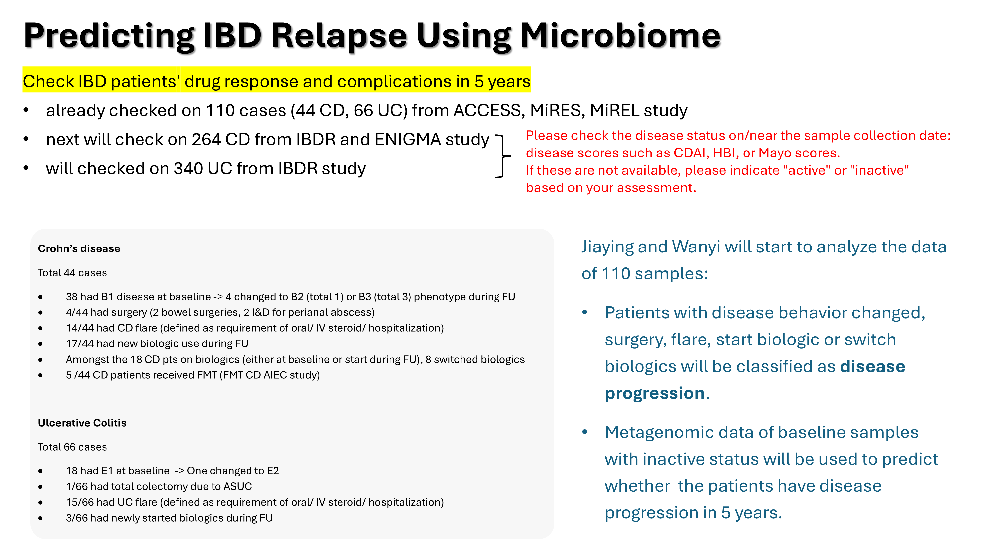

Slide 2
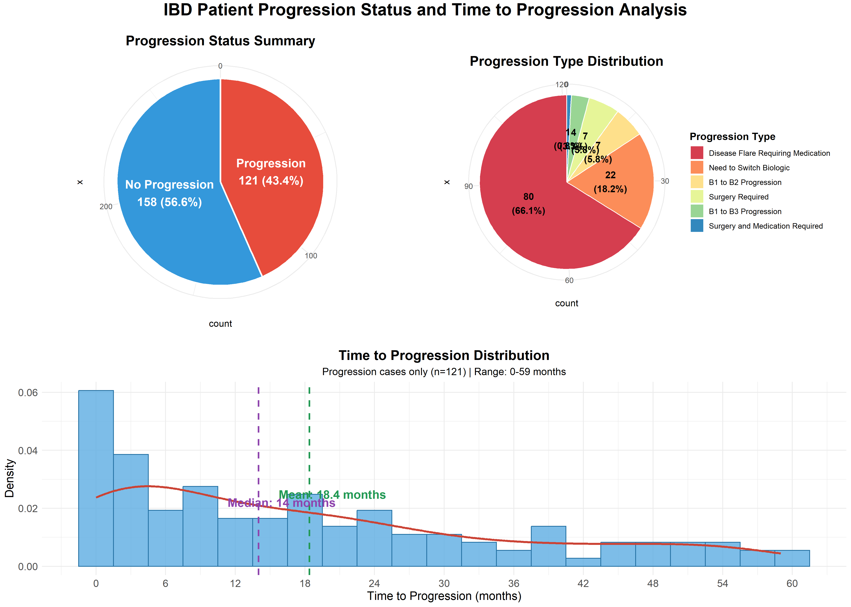
ENIGMA | IBDR | Longitude
75 | 173 | 31

Slide 3
Question list
1. Only the first recorded flare event date is used for analysis.
2. Patients who showed no progression and were lost to follow-up during the 5-year period have been excluded: CD058, CD077, CD111, HK1007, HK1021, HK1031, HK1084, ACC0107, ACC0085, ACC0118, ACC0072
3. When calculating flare times in months, for entries missing the exact day (only month and year available), I used the first day of the month as the default.
4. For patient HK1054, both medication and surgery times were recorded as May 2022. These dates have been standardized to May 1, 2022 (Reference #3).
5. A entriy marked "n/a (*E admitted at st. T, only known Abx was given)" in "Flare_requiring_oral_IV_Steroids_Hospitalisation (1: Yes; 0: No)", there is a relevant date but no clear classification. We are currently treating it as 1.
6. In the "New drug use" column, some entries contain drug names (should be 0/1). Should these be converted to 1?
7. Should the dates be matched with the Flare column or the Steroid column? Dates align completely with Steroid entries and mostly with Flare entries. Currently, we use Flare column to classify the samples.
8. Some samples show zero intervals in medication progressions. (So strange…)
Flare_requiring_oral_IV_Steroids_Hospitalisation (1: Yes; 0: No) | 5ASA | Thiopurines | MTX | Steroid (Oral/ IV) | Date

Slide 5
